Slide 1
Treatment Outcomes and Lessons Learned: The Evaluation Project of Residential Rehabilitation at Odyssey House NSW
Friday, 21 August 2020 at 10:00am
Julie Babineau – CEO, OHNSW
Mark Stevens – Clinical Services Manager, OHNSW
Toby Newton-John – Associate Professor, UTS
David Kelly – Director, Residential Services, OHNSW

Slide 2
Project Aims
Primary research questions:
Does residential rehabilitation improve the substance misuse, mental health, and physical well-being of clients?
Are these treatment gains maintained 3, 6 and 12 months following the client’s separation from the program?
Secondary research questions:
Are improvements in outcome variables associated with progression through the program?
How do clients reflect on their experience of the program at separation, and how do their reflections change over time?

Slide 3
Project Methods
Intake to Residential Rehab
Transition from each treatment level
1-4
Exit from Residential Rehab
3 months after exit
6 months after exit
12 months after exit
T1
Survey
T2
Survey + Interview
T3 Survey + Interview
T4
Survey + Interview
T5 Survey + Interview
Recruitment phase 12 months
Post treatment follow-up phase 12 months
Research assistant: Dr Rose Miller. 1 day UTS & 1 day OH

Slide 4
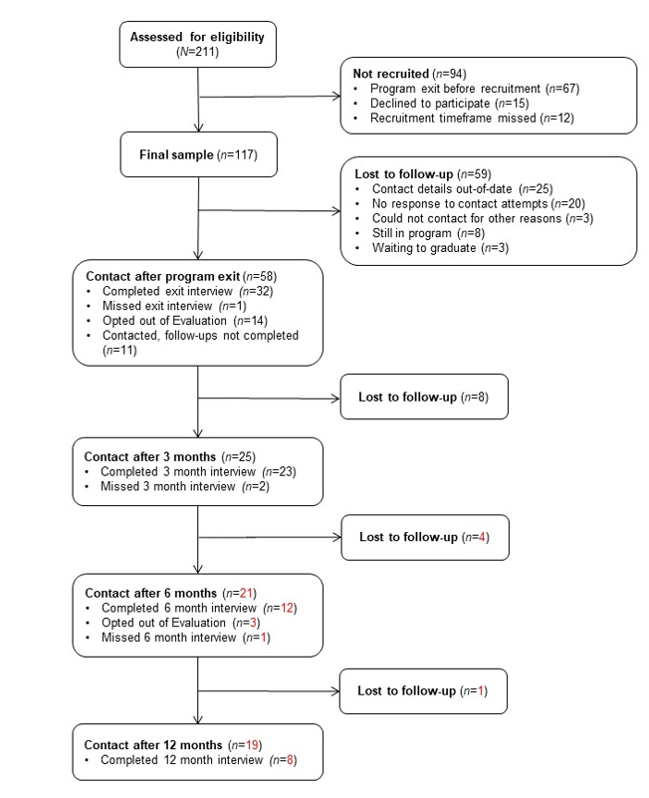
Project Methods
519 unique admissions
July 2017-July 2018

Slide 5
Project Methods
519 unique admissions
July 2017-July 2018
49% contacted after separation,
but only 27% gave follow up data

Slide 6
Results
N=117
Average age: 33 years
26% did not finish High School (41% of women); 49% no education after High School
33% self-referred to program; 13% criminal justice setting referral
Primary substance of concern:
ATS – 56%
Alcohol – 23%
Opioids incl. heroin – 12%
Detox prior to treatment: 62%
Received a mental health diagnosis ever: 45% men, 67% women
18% had two or more diagnoses
40% above cut-off on K10 indicating risk of significant mental health disorder

Slide 7
Results
Severity of dependence - SDS
Significant main effect of Time
(F(4, 83)=8.99, p<.001 )
Significant reduction in dependence
from intake to separation (p=.009).
Estimated marginal means of SDS scores for the Follow-up sample (n=33). Vertical bars denote 95% confidence intervals. Lower scores = less dependence.

Slide 8
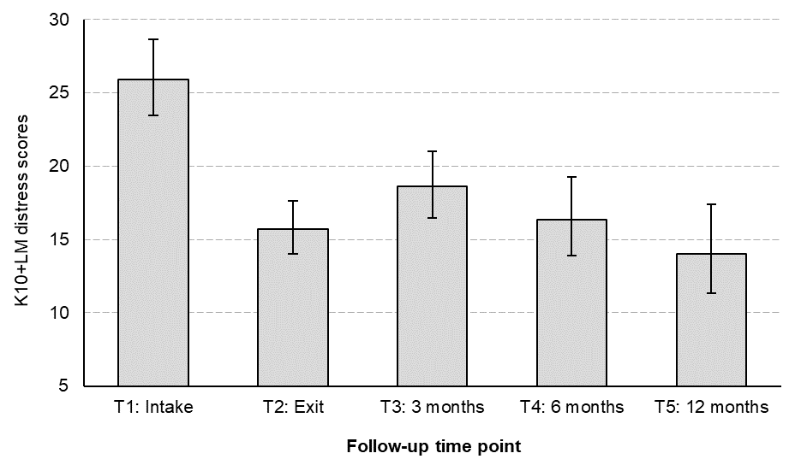
Results
Psychological distress – K10+LM
Significant main effect of Time (χ²(4) = 109, p<.001)
Significant reduction in
psychological distress from intake to
separation (p<.001).
High risk category:
Intake=14/33 (42.4%),
Exit=2/32 (6.3%),
3-month= 3/23 (13.0%)
Estimated marginal means of K10-LM scores for the Follow-up sample (n=33). Vertical bars denote 95% confidence intervals. Lower scores = less psychological distress.

Slide 9
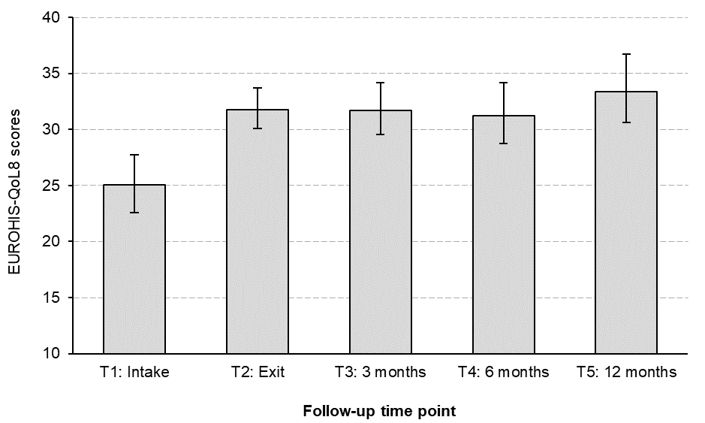
Results
Quality of Life – EUROHIS – QoL8
Significant main effect of Time
(F(4, 76)=15.94, p<.001)
Significant improvement in quality of life
from intake to separation (p<.001).
Improvement is maintained
3, 6, and 12- months after treatment.
Estimated marginal means of EUROHIS-QoL8 scores for the Follow-up sample (n=33). Vertical bars denote 95% confidence intervals. Higher scores = better quality of life.

Slide 10
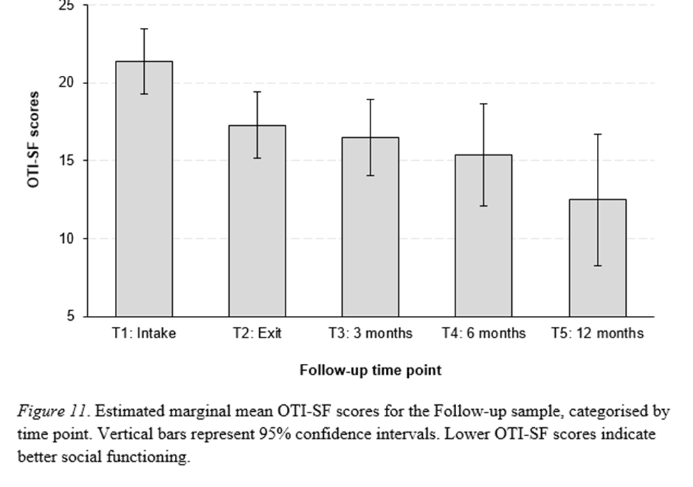
Results
Social functioning – the OTI-SF scale
Lower scores = Better social functioning.
Significant main effect of Time
F(4, 73)=6.46, p<.001 )
Significant improvement in social functioning from intake to separation (p<.001).
Improvement is maintained 3, 6, and 12- months after treatment.

Slide 11
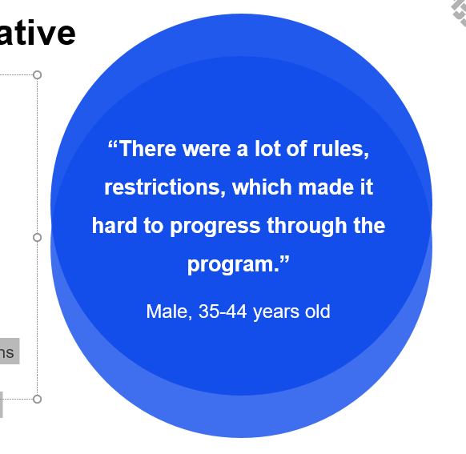
Results
Qualitative feedback - negative
Recurring themes
Disagreed with rules, restrictions
Lack of support with intense emotions
Reason for leaving
Family, financial or health reasons
Stagnation in treatment, time to move on
Asked to leave or discharged
Least helpful aspects of Odyssey House
Lack of support during treatment, too many restrictions
Structure of the program - procedures a hindrance
Nothing – program didn’t suit me, nothing to improve

Slide 12
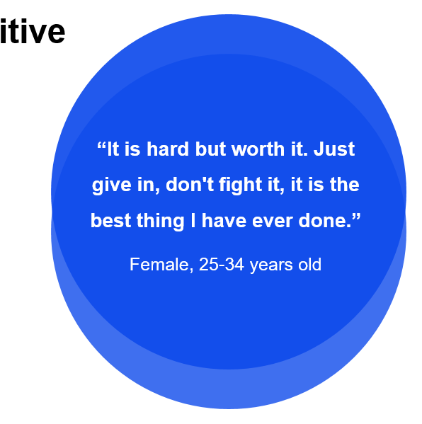
Results
Qualitative feedback - positive
Recurring themes
Commitment to treatment related to family
Social support – esp. peers, therapy staff
Advice for incoming residents
Trust and commit to the program
Hard, but worth it
Don’t give up
Most helpful aspects of Odyssey House
Therapeutic treatment – therapy, groups
Support network, psychoeducation (esp. about AoD)
Regular routine, schedule – structure of the program

Slide 13
A residential NGO Alcohol and Other Drug service has 3 primary objectives
1) To help as many suitable people as possible easily access treatment
2) For the majority of people to successfully reach their treatment goals
3) Post treatment, for the majority of people to maintain and develop their recovery.

Slide 14
The research highlighted 3 main areas of learning
A significant number of residents did not complete treatment
The majority of residents struggled with their mental health
Keeping in contact with people in follow-up was difficult.

Slide 15
Helping clients stay in treatment
Following the research we:
Introduced early stage Social Anxiety groups
Introduced early stage psychoeducation groups.
Introduced early stage recovery planning and relapse prevention
Introduced a short program for clients not needing longer term residential treatment

Slide 16
Mental Health
Employed more mental health specialists.
Provided more mental health focused groups.
Introduced “stepped” Mental Health Recovery groups.

Slide 17
After the program
More emphasis on post-residential recovery capital
VET training
Built stronger post treatment links with Community Services
Proactive follow-up for 6 months after completing the program

Slide 18
Conclusion
In response to the findings of this project, we have implemented a number of changes in our treatment program designed to:
Keep more clients in residential treatment
Help more clients improve their mental health
Help more clients to reach their recovery goals
However, further research and evaluation is needed to see if these changes improve the long term outcomes for our client group.

Slide 19
Where to from here?
Thank you!

