Slide 1
Asking the Question: How to ask sensitive questions
Suzie Hudson
Clinical Director, NADA

Slide 2
NADA proudly acknowledges the Gadigal people of the Eora Nation as the Traditional Custodians of the land on which our office stands. We extend this acknowledgement to all Aboriginal and Torres Strait Islander people across Australia and pay our respects to Elders past, present and future.

Slide 3
NADAbase team
Tata de Jesus Senior Project Officer
Suzie Hudson Clinical Director
Rosemaree Miller
Research and Data Management Officer

Slide 4
Key learning objectives
Identify and review foundational skills in building good relationships with clients
Apply skills in rapport building/active listening and find the ‘middle ground’ when talking to clients about sensitive topics
CAPABILITY FRAMEWORK
Reflects Capabilities:
3 Access and Equity,
4 Ethical, Safe and Responsible Practice and
6 Treatment Interventions

Slide 5
Overview
Confidentiality and Privacy
Ethical considerations
Informed consent
Preparing to ‘ask the question’
Sensitive questions in NADAbase
Role play – Screeners, the COMS

Slide 6
Confidentiality and Privacy
It is normal to feel nervous when ‘asking the question’
Clients have a right to confidentiality and privacy
However…asking sensitive questions is sometimes the best way to help a client

Slide 7
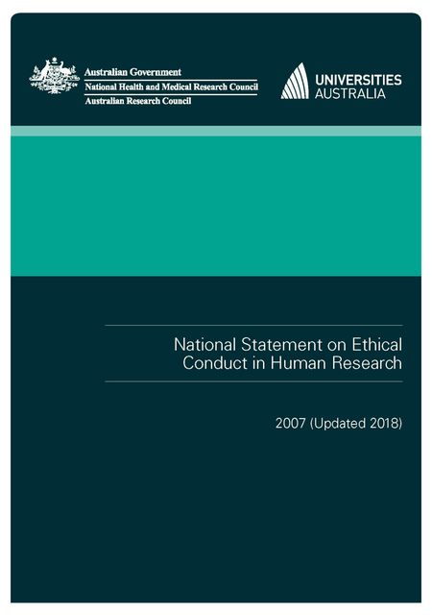
Ethical considerations
National Statement on Ethical Conduct in Human Research (2007; update 2018)
Respect for human beings
Research merit and integrity
Justice
Beneficence
https://www.nhmrc.gov.au/about-us/publications/national-statement-ethical-conduct-human-research-2007-updated-2018
Notes:
Guidelines that all Australian Human Research Ethics committees follow
Ensures ethical practice is consistent across all research which involves humans
Relevance for practice – not only for “publication”. Guidelines like this represent the commitment of modern-day researchers to preventing ethical misconduct in data collection and the use of data for research. Equally applicable to a service setting.

Slide 8
Informed consent
Does the client understand why the data is being collected?
Has the client been able to ask questions about the data?
Does the client know that answering the questions is voluntary?
Consent can be oral, written, implied (e.g., completing a survey)

Slide 9
Preparing to ‘ask the question’
The preamble
Have an idea of how you’ll start beforehand
Consent, and why are the questions being asked?
Have a conversation first
Have your materials ready

Slide 10
Risk monitoring
Pay attention to how the client is reacting
Is the client closed off, uncomfortable or nervous?
If the client discloses something personal, do you have the resources on hand to respond?
Pay attention to how you are reacting
Are you uncomfortable or nervous?
Is there a clear process on how to respond to a personally-revealing answer?

Slide 11
Risk monitoring
Pay attention to the environment
Is the setting appropriate and welcoming?
Is it private?
Do they feel at ease?

Slide 12
Sensitive questions in NADAbase
The MDS
Aboriginal and Torres Strait Islander
Sexuality
Gender
Injecting drug use
Children in care
Screeners
Blood-Borne Virus and Sexual Health
Domestic Family Violence
Suicide
The COMS
Severity of Dependence
Kessler Psychological Distress (+)
Quality of Life (WHO8 QoL)
BBV Exposure Risk taking
Assessing Nicotine Dependence
Australian Treatment Outcome Profile (ATOP)

Slide 13
Pictures
Images (pixabay.com):
https://pixabay.com/vectors/counselling-advice-therapist-3630323/
https://pixabay.com/photos/lock-padlock-heart-metal-grunge-1516241/
https://pixabay.com/illustrations/ethics-morality-credibility-2110558/
https://pixabay.com/photos/psychology-psychotherapy-531071/

