Slide 1
Coronavirus
(COVID-19) infection control
A focus on residential AOD treatment
Thursday 30th April 2020, 3-4pm
Dr Tony Gill, Chief Addiction Medicine Specialist, Centre for Alcohol and Other Drugs, NSW Ministry of Health
Kathy Dempsey, Clinical Excellence Commission, NSW Health
NADA member organisations – Triple Care Farm and Kedesh Rehabilitation Services

Slide 2
Welcome
Current best practice approaches to infection control in response to COVID-19 with a focus on residential services
What adaptations can services make to continue operating and reduce risks?
Residential service scenarios for consideration
NGO service providers share their established infection control and intake processes
Discussion and Q&A

Slide 3

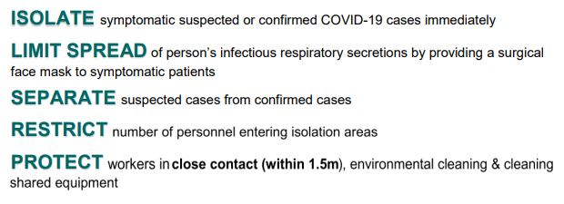
Infection control for residential services

Slide 4
Scenarios and guidance for service providers
Scenario 1
A medium size residential rehabilitation service has closed their facility in response to COVID-19 risk, and have supported clients via telehealth.
The organisation now want to re-open the facility for residential services.
What steps should they take in preparation for returning to intake and residential services?
What screening measures can be implemented to prevent COVID-19 infections entering the facility?

Slide 5
Scenarios and guidance for service providers
Scenario 2
A residential rehabilitation service has continued to intake new clients at a reduced capacity throughout the pandemic.
The service routinely monitors the temperature of staff and clients as an infection control measure.
A client records a high temperature and reports feeling lethargic so the service isolates the client into a room on their own within the facility.
Should the service return the client to the community for 14-day isolation?
If so, what should the organisation and client do in order to return to the service?
What measures should be taken with the other clients in the facility?

Slide 6

Scenario related Q&A
What PPE is required to return to intake and residential service delivery?
How accurate is temperature checking, and should it be a routine protection measure, including if we don’t have medical or nursing staff?
Would routine COVID-19 testing and clearing of clients by referring services (i.e. residential withdrawal management) provide guarantee that clients are virus free? If no, why not?
What measures should non-residential services put in place for a return to face-to-face counselling and support?

Slide 7

Established NGO infection control and intake processes
The following NGO service providers share their infection control and intake processes:
Danielle Breeze, Kedesh Rehabilitation Services
Gabriella Holmes, Triple Care Farm, Mission Australia
Questions
What changes did you make to your intake processes after COVID-19?
What adaptations did you make to your service delivery to comply with COVID-19 requirements?
How have you managed client concerns?
How have you managed staff concerns?

Slide 8
Questions?
Coronavirus (COVID-19) infection control
A focus on residential AOD treatment
Dr Tony Gill, Chief Addiction Medicine Specialist, Centre for Alcohol and Other Drugs, NSW Ministry of Health
Kathy Dempsey, Clinical Excellence Commission, NSW Health
NADA and member organisations – Triple Care Farm and Kedesh Rehabilitation Services

