Slide 1
Client directed care
An evaluation of the new client centred care model used at Kedesh Rehabilitation Services
Peter J. Kelly, Mark Buckingham, Esther L. Davis, Kathryn Hinsley, Frank P. Deane,
Danielle Breeze, David Reid & Sarah Adams

Slide 2

We acknowledge the traditional custodians of the lands on which UOW is situated.
We pay our respects to Aboriginal Elders past and present, who are the knowledge holders and teachers.
We acknowledge their continued spiritual and cultural connection to Country. As we share knowledge, teaching, learning and research within their University, we also pay respect to the knowledge embedded forever within Aboriginal Custodianship of Country.

Slide 3
Acknowledgements
AOD Early Intervention
Innovation Fund,
NGO Evaluation Grant Scheme

Slide 4
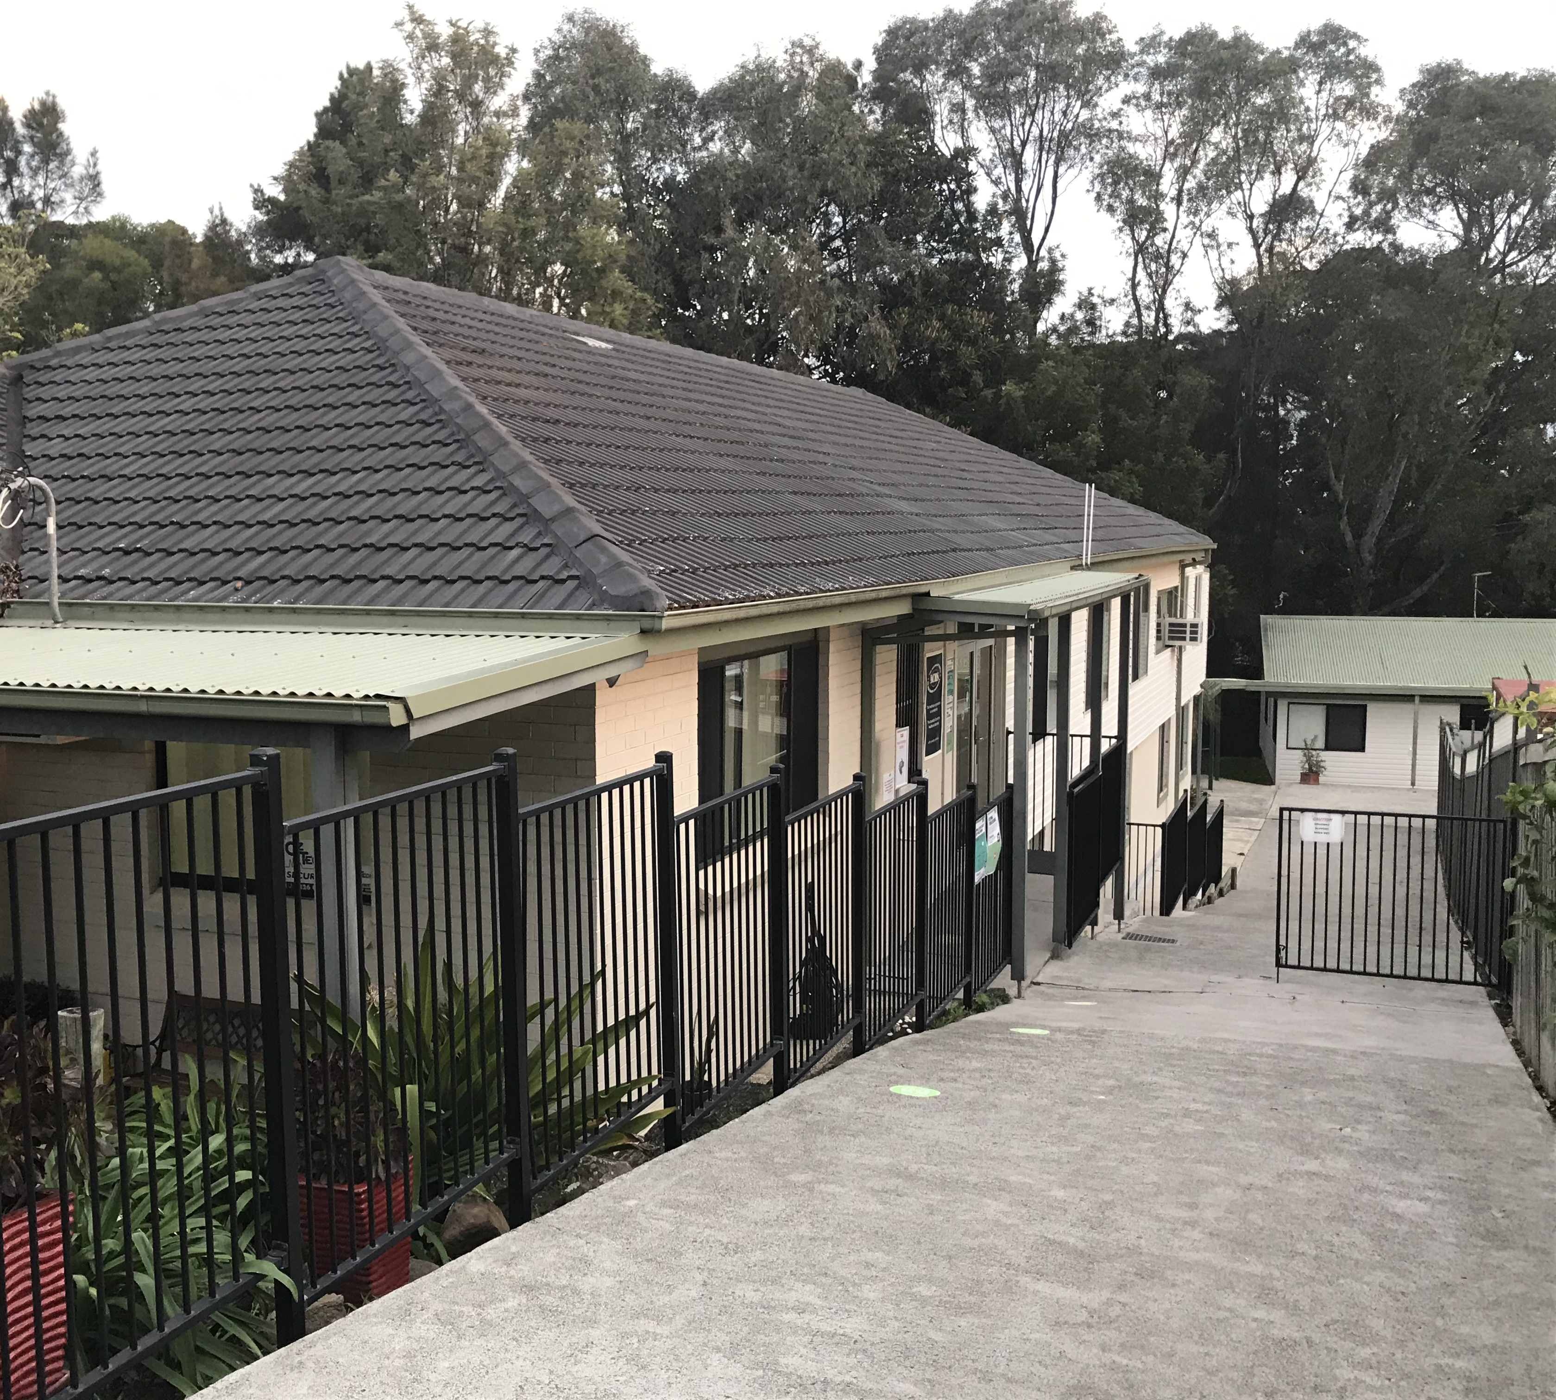
Kedesh Rehabilitation Services
Established in 1977
Currently have sites in the Illawarra & Mona Vale
Historically 8-week residential program
2016 transitioned to a client centred care model

Slide 5
Project Overview
Study aims
  Examine Kedesh clients experience with this new client centred care model
Program of research
  Systematic review
  Development of a patient reported experience measure (PREM)
  Evaluation of the Kedesh model
    Mixed methods

Slide 6
Client Centred Care
(or person centred care, patient centred care)
Advocated by the NSW Health, World Health Organisation, ICHOM, Agency for Clinical Innovation (ACI)
“Response to care that is respectful of and responsive to individual client preferences, needs and values” (Institute of Medicine, 2001).
Rather than a one-size fits all approach, it really values individual client needs and preferences
It’s a challenging proposition for residential services

Slide 7
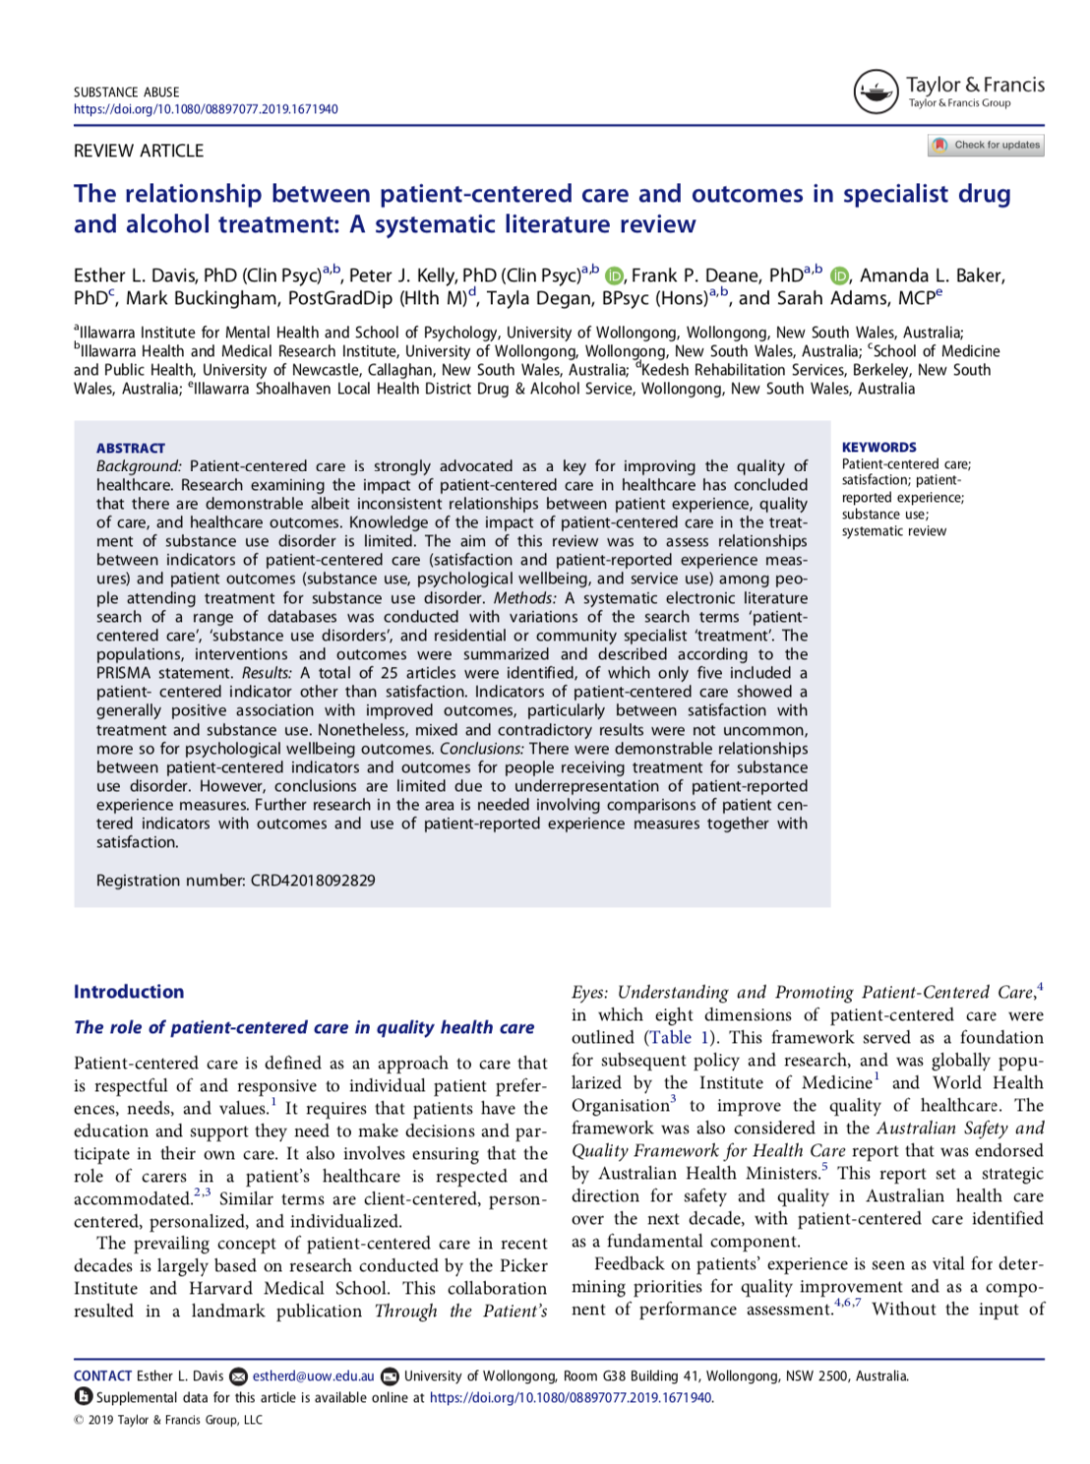
Systematic Review
Aim: Examine the relationship btw patient centred care & outcomes
25 articles were included
Small but consistent correlation btw client centered care & outcomes
Research has largely focused on satisfaction
Lack of specific Patient Report Experience Measures (PREMs) in AOD
Notes:
Patient experience measures tend to ask factual questions about what did or did not occur during an episode of care, while satisfaction measures ask people to provide a subjective and more affective based response.

Slide 8
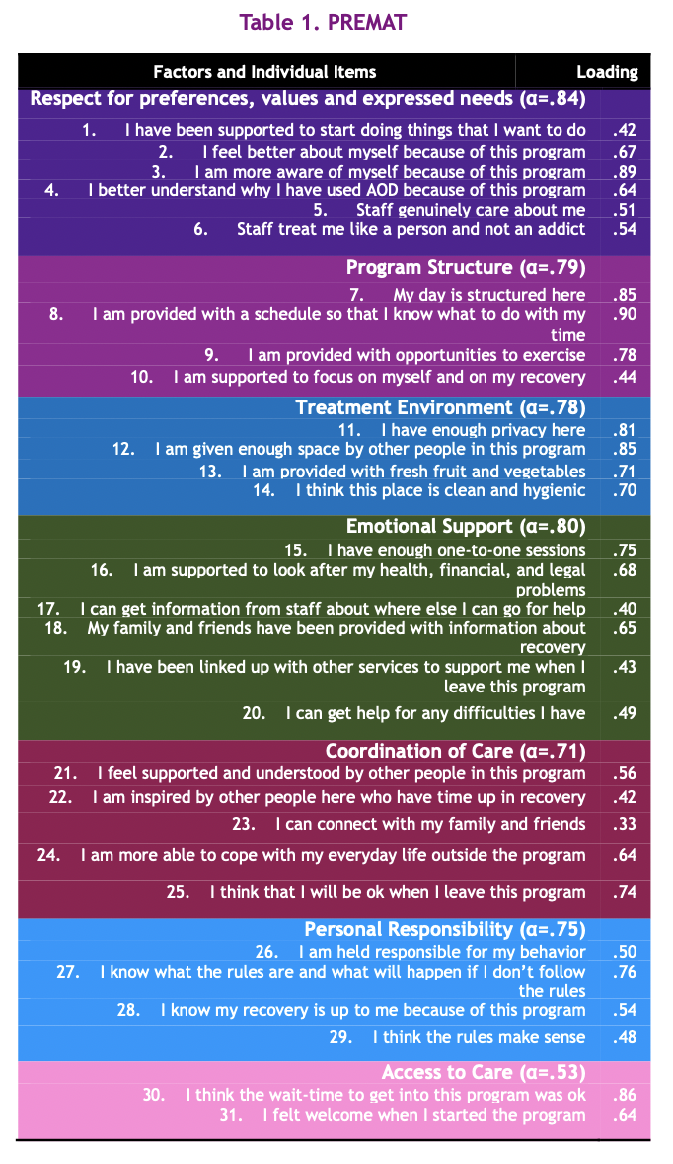
PREM for Addiction Treatment (PREMAT)
1. Focus groups
Across 5 different AOD services in NSW
2. Developed a draft questionnaire
Expert panel of people attending AOD treatment & experienced AOD workers
3. Final draft of PREMAT
31-items + two open ended questions
Hinsely, Kelly & Davis (2019), Drug and Alcohol Review
4. Psychometric study (N = 222)
Factor analysis completed
Paper still to be submitted for peer review
Notes:
Patient experience measures tend to ask factual questions about what did or did not occur during an episode of care, while satisfaction measures ask people to provide a subjective and more affective based response.³⁵ Satisfaction measures tend to elicit highly positive ratings that can obscure problems with specific processes that affect the quality of care delivery.^{28,29} It is not uncommon to find that “highly satisfied” patients report significant problems if factual questions are asked about whether or not certain processes and events occurred.^{28,29}

Slide 10
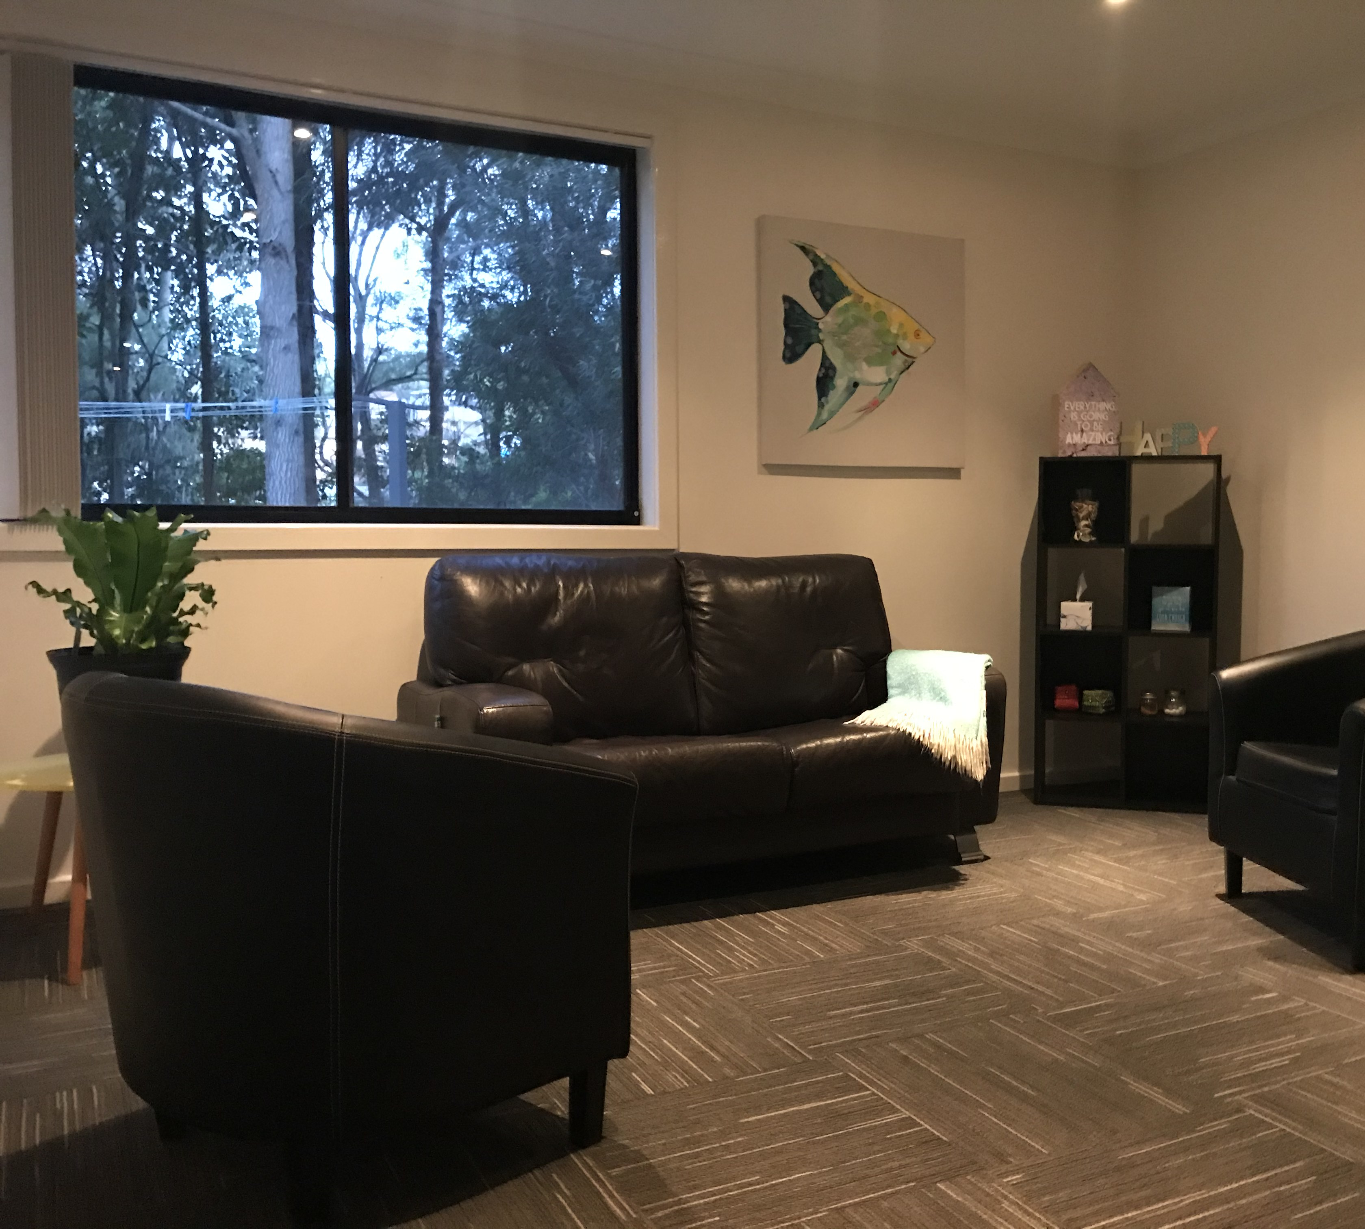
Evaluation of new Kedesh Client Centred Care Model
Research Questions
Is Kedesh delivering a model consistent with client centred care?
Do clients value the experience of the new modal?
What are staff perspectives on the new model?

Slide 11
Quantitative results
Methods
  Longitudinal study of participants across treatment (N = 70)
  Assessments: Baseline, Week 4 and 7 and 1-mth post treatment
  NADA base, Substance Use Recovery Evaluator, PREMAT, Treatment Perceptions Questionnaire
Results
  When compared to baseline, participants demonstrated improvements on all outcome measures (i.e. they improve in treatment)
  Client experience remained consistently high (PREMAT)

Slide 12
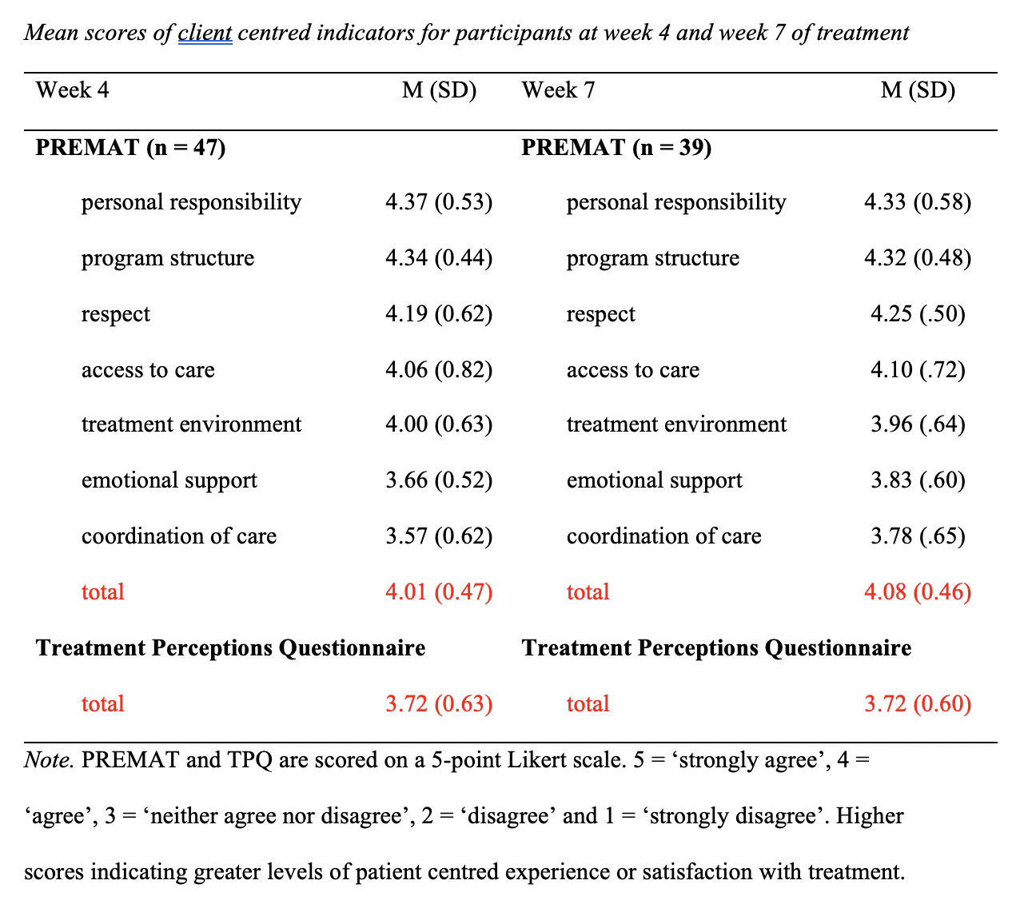

Slide 13
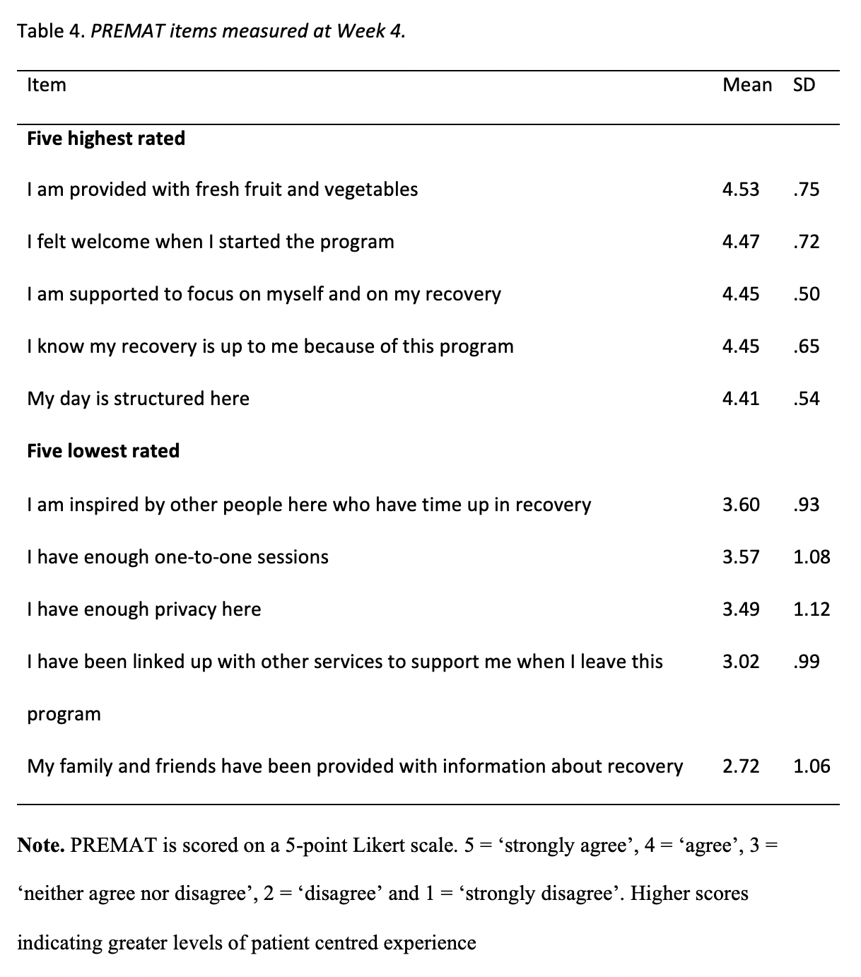

Slide 14
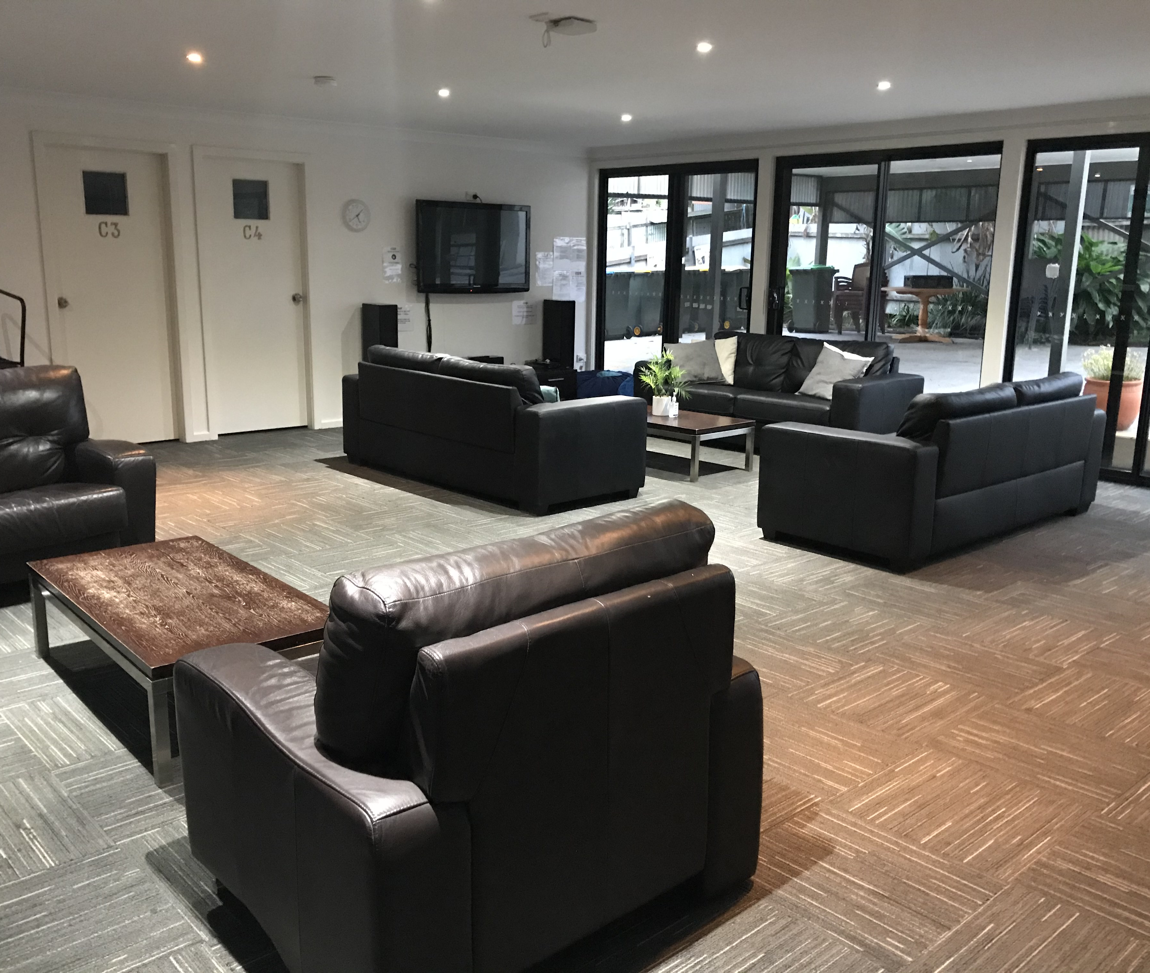
Qualitative results
Methods
Four client focus groups (18 clients)
Individual staff interviews (8 staff)
Thematic analysis

Slide 15
Kedesh: core themes of client centred care
Themes | Description
Flexible | Treatment is flexible & adaptive to individual needs Flexibility around: extensions, re-entry, length of stay & leave
Comprehensive | Really considering the holistic needs of people accessing the service. As a result, care becomes more comprehensive and in-depth
Open minded | Staff holding an open-minded attitude to how treatment ’works’ Questioning, challenging & discussing strategies
Inclusive | Actively acknowledging the autonomy of clients to make choices Involving clients in decision making

Slide 16
Kedesh staff & clients: Benefits & Challenges
Themes | Benefits | Challenges
Flexible | Individualised care Appreciated choice (C) | Consistency Clients described sometimes ‘unfair’
Comprehensive | Holistic care Address all needs (C) | Logistical complexity Depth of care can be confronting for clients (C)
Open minded | Enterprising Clients having greater agency (C) | Resource intensive Client uncertainty around decisions (C)
Inclusive | Satisfying “staff get that genuine sense of doing what’s best for the individual” ‘compassionate care’ (C) | Anxiety provoking

Slide 17
Conclusions
The client centred care model is well integrated at Kedesh
Staff & clients can clearly describe the model and report that it is beneficial
Future directions for the sector
Guidance document supporting client centred care
  Consider staffing levels in the NGO sector
Experience and satisfaction should be routinely used across the sector
  Interviewing clients should form part of evaluations

Slide 18
Questions
A/Prof Peter Kelly
School of Psychology pkelly@uow.edu.au

