Slide 1
Evaluation of the Ted Noffs Foundation Street University Program
UNSW evaluation team:
A/Prof Joanne Bryant, A/Prof Limin Mao,
Ms Elena Cama, Dr Rebecca Gray
Centre for Social Research in Health

Slide 2
The evaluation sought to:
determine the effectiveness of the engagement program in engaging pre-service young people, and in maintaining engagement with them over the longer term
ascertain the impact of the program on clients’ substance use, mental health, and criminal involvement, along with other outcomes.
qualitatively describe staff and clients’ perspectives about program goals and mechanisms

Slide 3
Evaluation design and data sources
Prospective observational cohort: baseline, 3 months, 6 months
All new entrants: changes in outcomes for attenders and non-attenders
Primary outcome measures: SDS, substance use in past 4 weeks, K10 Psychological distress, police contact
Baseline n=316 ….… recaptured n=95 (RR 30%)
Analysed for: changes in outcomes within ‘attended’ and ‘did not attend’ groups; changes in outcomes using a dose-response type analysis correlating number of hours spent at the service with outcomes
Qualitative in-depth interviews with clients and staff
Loosely based on Realist Evaluation method (Pawson and Tilley, 1997) focusing on perceived program outcomes, mechanisms and contexts
n=22 clients, n=5 staff
Street Uni therapeutic counselling data
2014-19 data on therapeutic intervention episodes (not all clients)
Clients who completed three or more counselling appointments n=161
Notes:
Non-attenders are our control

Slide 4
Finding 1: Street Uni has an impressive capacity to attract and retain pre-service youth over the long term
“It’s a good place for young kids who don’t have a chance at home. Yeah. […] There’s people here that care. Kids need help with homework. Kids need help with assignments. There’s people here. Whereas, if they’re at home and they have parents that don’t care, you know? […] Also, people round here don’t have the best things. And the fact that we can come here and use the things we want for free is…it’s a big deal.”
Of participants enrolled at baseline…
63% of participants returned at least once
54% returned weekly or more often
average of two hours each time, half stayed for longer than two hours.
Of those who did not return, reasons provided related to work, study and family obligations.

Slide 5
Who are Street Uni clients?
N (%) | Attended (n=60) | Did not attend (n=35) | p-value
Male | 26 (43) | 17 (49) | NS
Age M (SD), Range | 17.18 (2.58), 14-24 | 17.26 (2.68), 14-24
Currently at school | 26 (43) | 17 (49) | NS
Currently employed | 8 (13) | 10 (29) | 0.07
K6 Psychological distress | 15.6 | 15.1 | NS
Probable serious mental illness % | 21 (35) | 8 (23) | NS
Crime cumulative outcome (last 3 months) | 0.8 | 1.1 | NS
Interviewed by police | 10 (17) | 9 (26) | NS
Given formal warning or police caution | 12 (20) | 7 (20) | NS
Reports any drug to be of concern | 28 (47) | 10 (28) | NS
Drank in last 4 weeks | 37 (62) | 23 (66) | NS
Used Cannabis in last 4 weeks | 24 (40) | 14 (40) | NS

Slide 6
Who are Street Uni clients?
N (%) | Attended (n=60) | Did not attend (n=35) | p-value
Male | 26 (43) | 17 (49) | NS
Age M (SD), Range | 17.18 (2.58), 14-24 | 17.26 (2.68), 14-24
Currently at school | 26 (43) | 17 (49) | NS
Currently employed | 8 (13) | 10 (29) | 0.07
K6 Psychological distress | 15.6 | 15.1 | NS
Probable serious mental health problems % | 21 (35) | 8 (23) | NS
Crime cumulative outcome (last 3 months) | 0.8 | 1.1 | NS
Interviewed by police | 10 (17) | 9 (26) | NS
Given formal warning or police caution | 12 (20) | 7 (20) | NS
Reports any drug to be of concern | 28 (47) | 10 (28) | NS
Drank in last 4 weeks | 37 (62) | 23 (66) | NS
Used Cannabis in last 4 weeks | 24 (40) | 14 (40) | NS

Slide 7
Types of activities undertaken, attenders
General activities | N (%)
Hang out with friends | 48 (89)
Hang out with staff | 24 (40)
Use computers | 29 (48)
Taken food package home | 10 (17)
Counselling
Talk to counsellors about my use of alcohol or drugs | 5 (8)
Talk to counsellors about my mental health | 8 (13)
Workshops and classes
Music workshops/classes | 15 (25)
Dance workshops/classes | 15 (25)
Art workshops/classes | 6 (10)
Cooking/food preparation classes | 8 (13)
Help from staff
Talked to staff about other services (e.g. doctors, employment) | 9 (15)
Talk to staff about school, TAFE, uni or jobs | 6 (10)
Talk to staff about other issues or problems in my life | 10 (17)

Slide 8
Types of activities undertaken, attenders
General activities | N (%)
Hang out with friends | 48 (89)
Hang out with staff | 24 (40)
Use computers | 29 (48)
Taken food package home | 10 (17)
Counselling
Talk to counsellors about my use of alcohol or drugs | 5 (8)
Talk to counsellors about my mental health | 8 (13)
Workshops and classes
Music workshops/classes | 15 (25)
Dance workshops/classes | 15 (25)
Art workshops/classes | 6 (10)
Cooking/food preparation classes | 8 (13)
Help from staff
Talked to staff about other services (e.g. doctors, employment) | 9 (15)
Talk to staff about school, TAFE, uni or jobs | 6 (10)
Talk to staff about other issues or problems in my life | 10 (17)

Slide 9
Types of activities undertaken, attenders
General activities | N (%)
Hang out with friends | 48 (89)
Hang out with staff | 24 (40)
Use computers | 29 (48)
Taken food package home | 10 (17)
Counselling
Talk to counsellors about my use of alcohol or drugs | 5 (8)
Talk to counsellors about my mental health | 8 (13)
Workshops and classes
Music workshops/classes | 15 (25)
Dance workshops/classes | 15 (25)
Art workshops/classes | 6 (10)
Cooking/food preparation classes | 8 (13)
Help from staff
Talked to staff about other services (e.g. doctors, employment) | 9 (15)
Talk to staff about school, TAFE, uni or jobs | 6 (10)
Talk to staff about other issues or problems in my life | 10 (17)

Slide 10
Types of activities undertaken, attenders
General activities | N (%)
Hang out with friends | 48 (89)
Hang out with staff | 24 (40)
Use computers | 29 (48)
Taken food package home | 10 (17)
Counselling
Talk to counsellors about my use of alcohol or drugs | 5 (8)
Talk to counsellors about my mental health | 8 (13)
Workshops and classes
Music workshops/classes | 15 (25)
Dance workshops/classes | 15 (25)
Art workshops/classes | 6 (10)
Cooking/food preparation classes | 8 (13)
Help from staff
Talked to staff about other services (e.g. doctors, employment) | 9 (15)
Talk to staff about school, TAFE, uni or jobs | 6 (10)
Talk to staff about other issues or problems in my life | 10 (17)

Slide 11
Finding 2: Among new entrants, no measurable decreases in psychological distress, criminal contact or problematic substance use over 6 months
 | Attended (n=60) Mean (SD), range | Did not attend (n=35) Mean (SD), range
Psychological distress
Baseline | 15.60 (6.07), 6-30 | 15.06 (5.69), 6-25
Six month FU | 14.73 (6.21), 6-30 | 15.74 (5.67), 6-27
p value | NS | NS
Recent crime (cumulative)
Baseline | 0.83 (1.79), 0-8 | 1.06 (1.51), 0-5
Six month FU | 0.62 (1.26), 0-6 | 0.37 (0.77), 0-4
p value | NS | NS
Any drug of concern (vs no drug of concern)
Baseline | 28 (47) | 10 (29)
Six month FU | 23 (38) | 10 (29)
p value | NS | NS

Slide 12
Finding 3: Program data reveal those who take part in therapeutic counselling achieve significant improvements

Slide 13
Finding 4: Primary program outcomes are seen to be about building technical, life and social skills
program outcomes were seen by participants to be related to skill-building (technical, life and social skills) and less often about therapeutic outcomes such as mental health and substance use.
therapeutic intervention was seen to happen organically through participation in the engagement activities (music, art, dance), and not through directly linking clients to counselling services
I started making music and my cousin told me you can record here for free. I came for music, yeah […] I’ve done some counselling here but other than that, no, not really anything else. But I only get an hour per week. […] Music calms me down a lot. Helps me. It helps me express things that I can’t talk to people about. I find it hard speaking to people about my feelings, things like that.
(Jason)

Slide 14
Finding 5: Street Uni is highly valued by clients and is seen to work through 4 key mechanisms
“A lot of it is probably like when we all hang out on the streets it’s like we get pulled up by cops or snubbed by random people, looked down on by everyone. But when we are at Street Uni you know, it’s a safe place for us to be who we wanna be without getting judged or pulled up.” (Sasha)
it provides a safe and inclusive space for young people who often do not experience safety in their homes or in public spaces;
it provides the opportunity for young people to develop positive relationships with adult;
it offers activities that are appealing and relevant to young people, and promotes an environment in which youth culture and agency are celebrated;
it seeks to employ these mechanisms over the long term to ensure that young people are sufficiently supported in their social, emotional, material and therapeutic needs.
I was expecting as soon as you open a door there’ll be a desk, a reception saying, “What are you doing here?” you know? No. Went and opened the door to the basketball court. I’m like, “What the …?” (Caleb)
through here like they help me get credited for work, doing, doing work here, volunteer work and such, and so that could go, that went on my, my, my resume for uni. I just told them, “Hey, I …” yeah. So I just told them like, “Hey, I’ve done this stuff with these guys before,” and they’re like, “Oh, pretty good.” So it really helped me get into uni. (Jude)

Slide 15
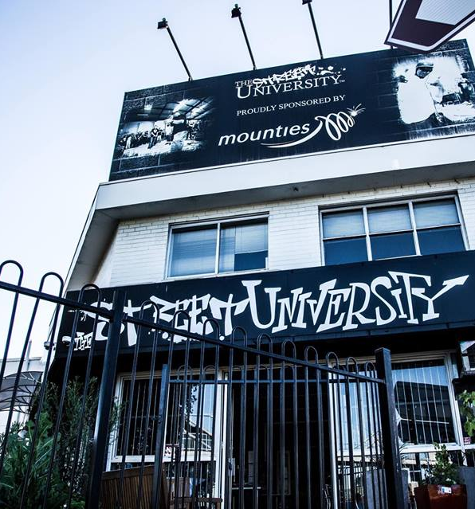
Our recommendations
Continue engagement activities as these are impressive in their capacity to attract and retain pre-service young people over the long term.
Develop clearer processes to identify clients in need of counselling and other mental health and AOD therapies.
Increase the skills of staff who work in engagement roles to improve their capacity to identify young people in need of counselling and other mental health and AOD therapies
Further develop the help-seeking skills of young people, especially since help-seeking is identified by young people as a valuable skill that they gained through their participation at Street University.

