Slide 1
Engaging with Families and Significant Others in the AOD sector.

Slide 2
Acknowledgement
We would like to begin by acknowledging the Traditional Owners of the land on which we
meet today.
I would also like to pay my respects to Elders past and present.
We recognise, respect and value the deep and continuing connection of Aboriginal and Torres Strait Islander people to land, community and culture.

Slide 3
Workforce Development Project
The project is a partnership between Ministry of Health, NADA, Family Drug Support and LHDs across NSW – South Western Sydney Local Health District
The key aim of the project is to build the sector knowledge, skills and confidence to support the families and significant others of people with problematic substance use
Notes:
Introduce the project and what the key aims are.

Slide 4
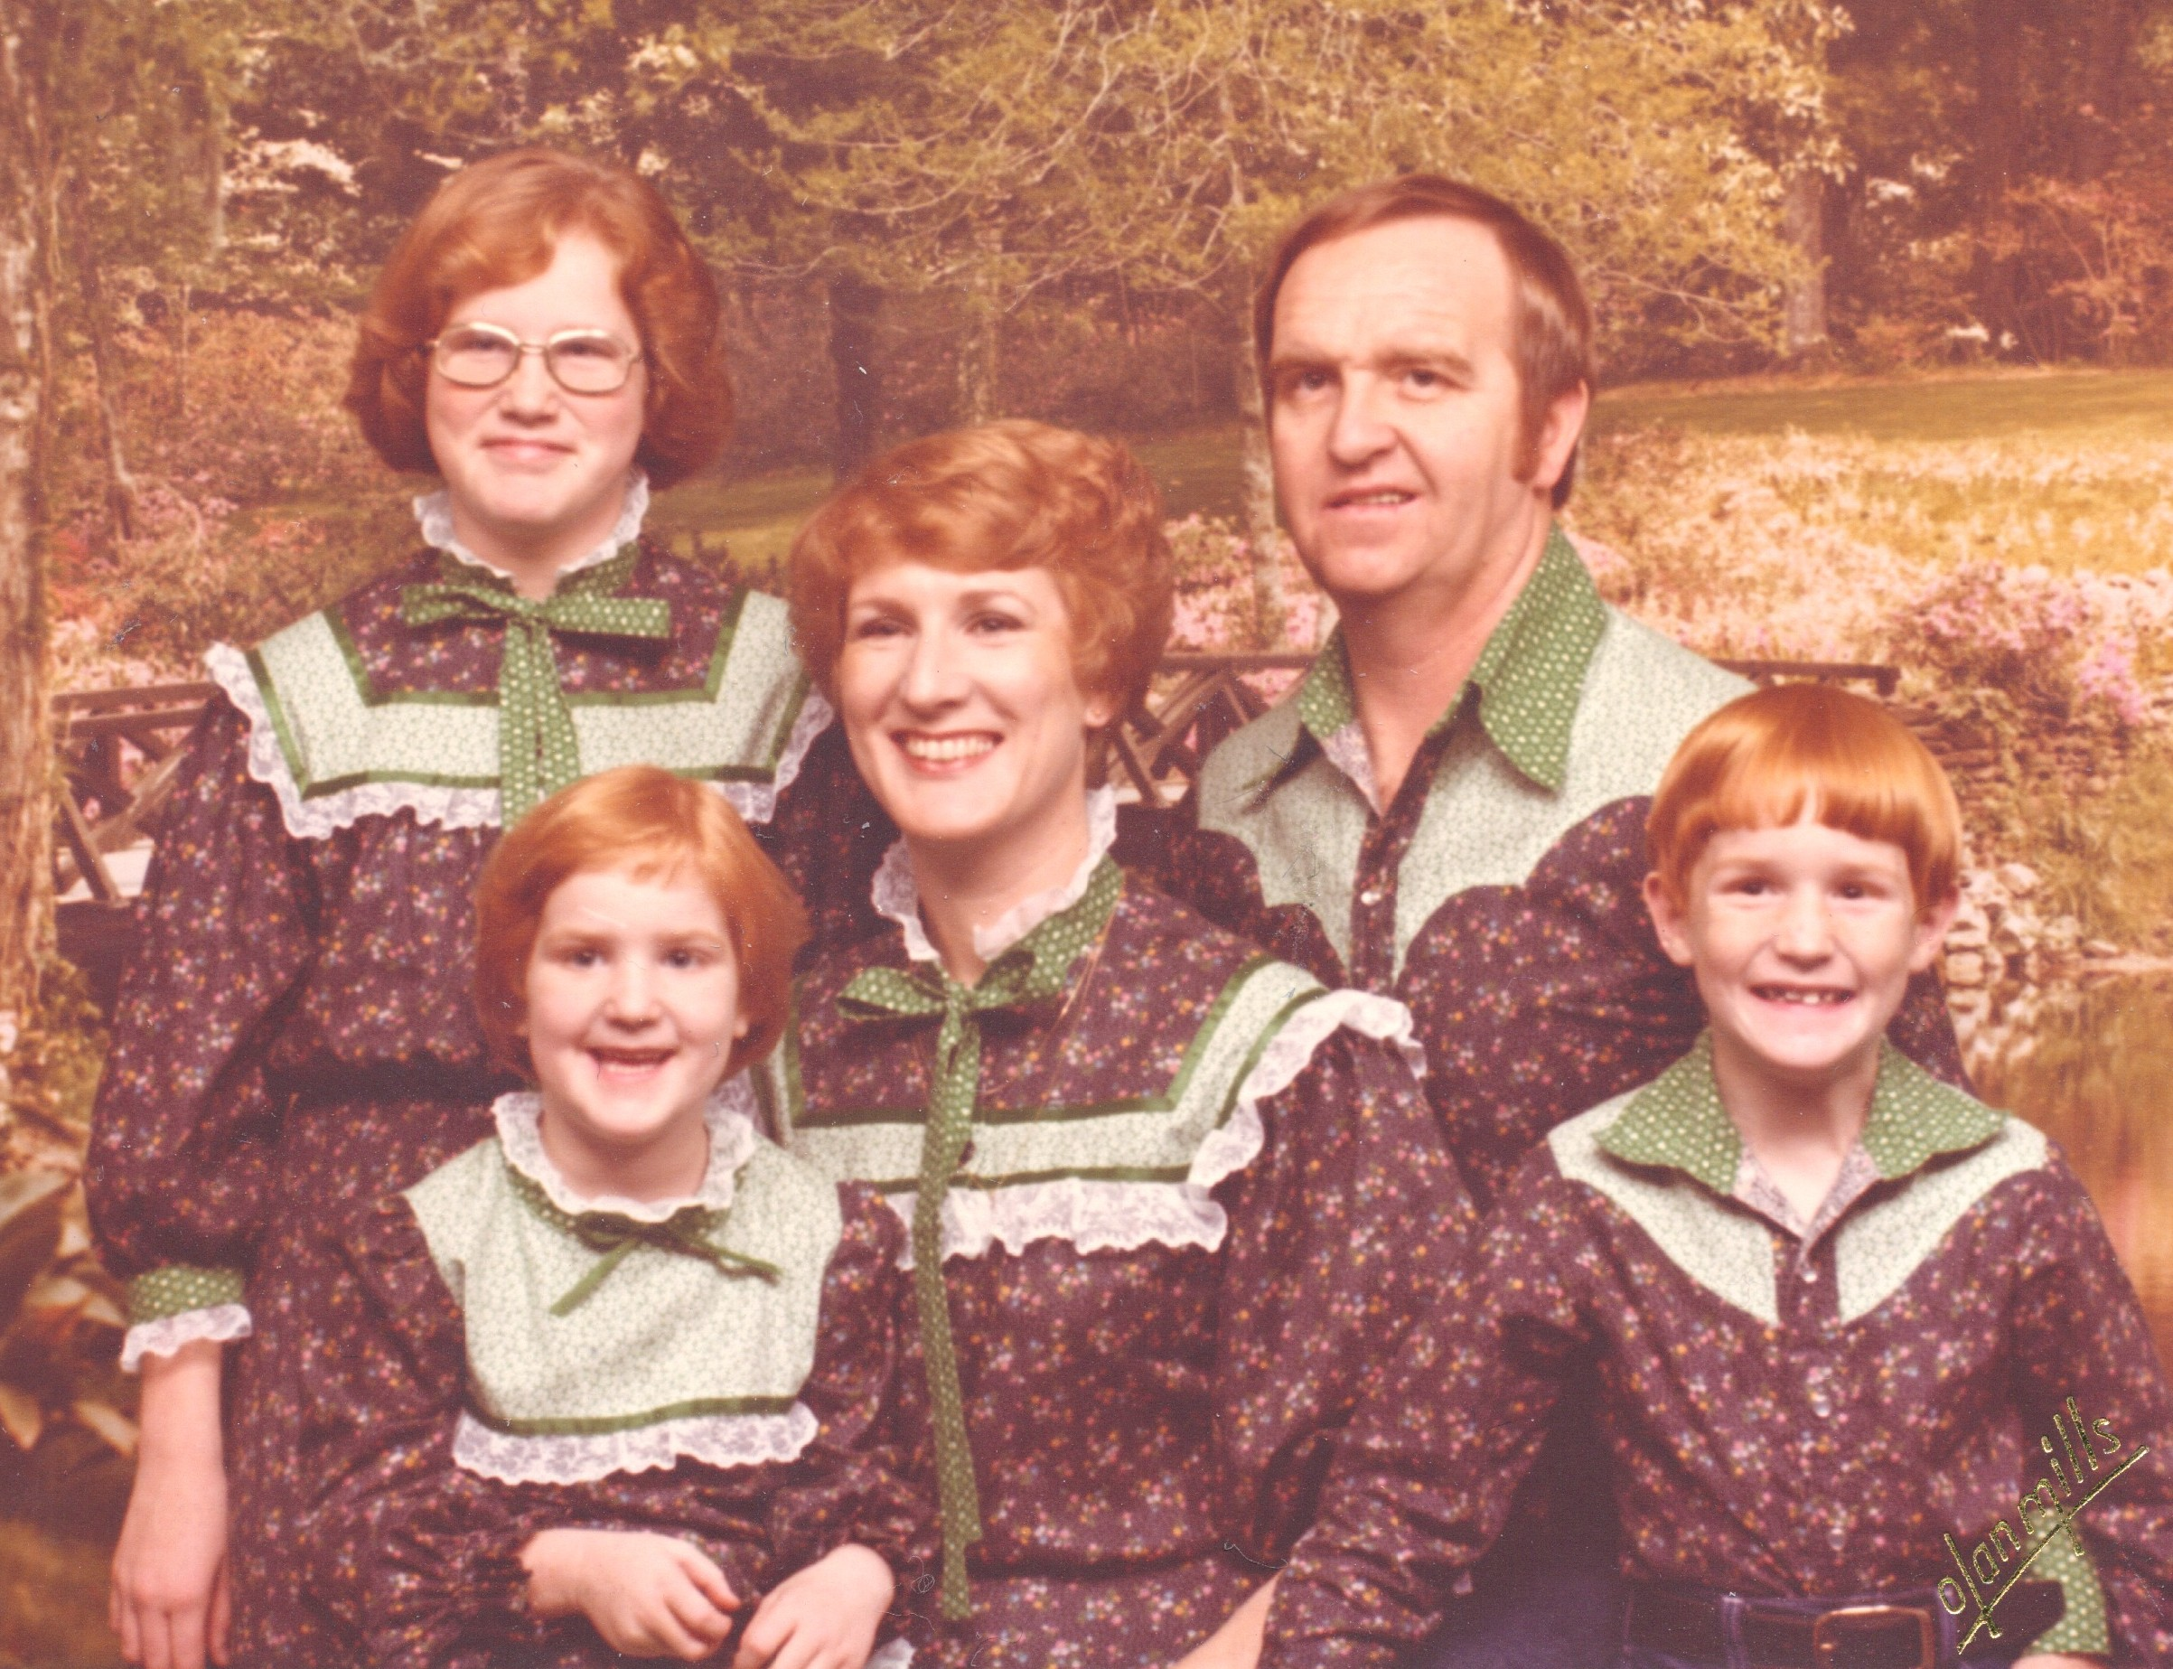
Workshop Overview

Slide 5
Workshop Objectives
To hear family/significant other experiences
Gain knowledge of Family Inclusive best practice principles and approaches to working with families of all kinds
Become familiar with AOD terminology and information that can be useful for families
Hear about local referral pathways
Notes:
Suzie to outlined the Workshop Objectives – and emphasise that this is an opportunity to build awareness/capacity in working with families and significant others to compliment/enhance the work you are already doing.
To network and find out about specialist services that have a focus on families, significant others

Slide 6
Introductions
What are your
experiences of working
with families
and significant others?
What would you
like to learn today?
Notes:
Introduction activity to warm up the room – Suzie to facilitate.
In pairs explore these questions and then feedback to the group.
White board the experiences and butcher paper the things people would like to learn

Slide 7
Before we proceed…
Safety
Respect
Confidentiality
Mindful disclosure
Need to step out?
Having fun
Network
Notes:
Safety and respect
This is a safe space.
There are no right or wrong opinions.
Share the ‘talk’ time. Don’t talk over others.
Speak up if you need support.
Confidentiality and mindful disclosure
We want everyone to feel comfortable sharing their views and experiences.
Staying focused
Please turn your phones on silent.
If you need to take a call or a break, please step outside.
Please return from breaks on time and let us know if you need to leave early.
Having fun
This is an interactive workshop. We want everyone to participate. Participation is voluntary.
Remember, there are no right or wrong opinions, or ‘dumb’ questions.
Anything else?
Is there anything else anyone would like to add so everyone feels safe and comfortable contributing?

Slide 8
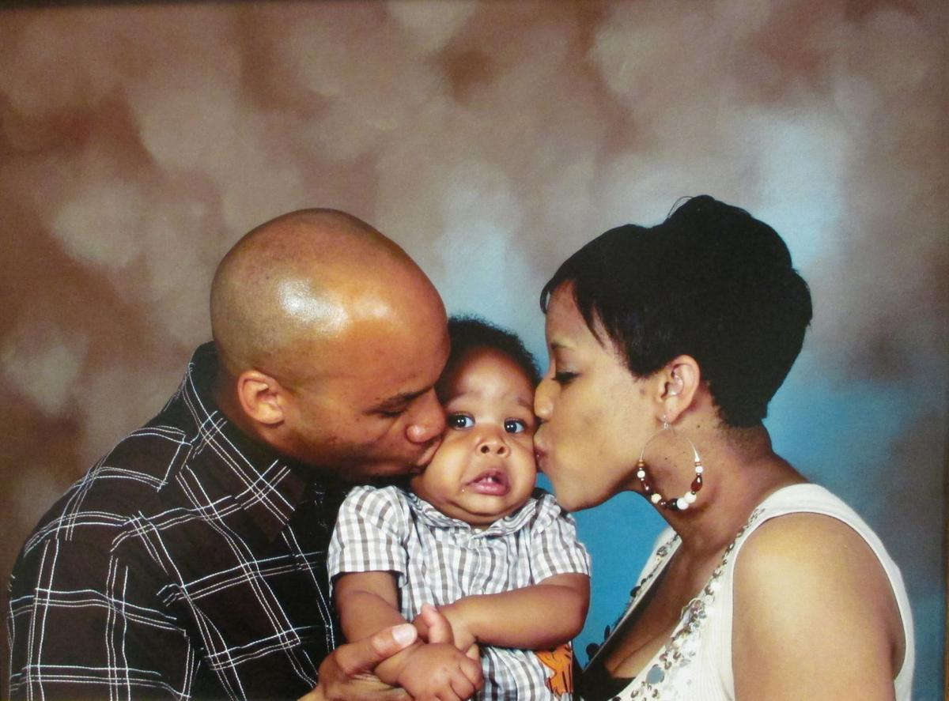
What is Family?
The meaning of family is broad and can include:
Immediate Family
Extended family
Partners
Friends
Carers
Anyone who plays a significant roles in someone’s life
Significant other and Chosen family
Notes:
Explore the concept of “family” and how it will be used in the context of this training. Ensure clarity that when we talk about family we mean in broad terms and that we need to be mindful about being inclusive –
when asking clients: “is there someone in your life that supports you? Or that might be supportive of this step you are taking?”
When asking family/sig others: How might you describe the connection you have with the person you have concerns about? Are there things that support you now that help with staying connected to the loved one you are concerned about? Are there other things that might further assist with maintaining your connection/support of XX?

Slide 9
Diversity in Families
Aboriginal families
Culturally and Linguistically Diverse Families
Chosen Family – LGBTI communities
“There is so much diversity within our own communities - there is no one ‘cookie-cutter’ relationship type”
Kai Noonan ACON
Notes:
Explore the way culture and community can shape our families and networks
Importance of interpreter services
Consulting with CALD and Aboriginal organisation’s – The Glen will be speaking today and about the families inclusive practices they have implemented
Cultural competence training

Slide 10
Family Drug Support
Notes:
A consumer representative from FDS will present to the group their experience of working with treatment services and what they found particularly helpful. Also to leave the group with some key things they felt were important in supporting them when concerned about the substance use of someone else.

Slide 11
Morning Tea
Notes:
Encourage Networking and finding out who is here in the room today that you might connect with later.

Slide 12
How do I include families and significant others in my practice?
Validate
Educate
Facilitate
Notes:
A quick rule of thumb to walk away from today is:
Validate – listen to the concerned family member, hear their distress and validate the way they are feeling
Educate – provide factual information that fits with where they are at
Facilitate – link them in with further supports, facilitate these introductions where you can

Slide 13
Providing basic AOD knowledge
Depressants, Stimulants and Hallucinogens
Intoxication and Overdose
Tolerance and Dependence
Treatment options
Notes:
Providing Information to families/significant others can be very useful – particularly when people are living together or socialising together. This needs to be balanced with providing too much information, that may increase concerns.
Exploring safety is useful. Also outlining treatment options and the continuum of services available.
Depressants
These include alcohol, benzodiazepines (minor tranquillisers), cannabis, GHB, heroin, morphine, codeine, methadone, and some inhalants.
Depressants do not necessarily make a person feel depressed. They affect the central nervous system, slowing down the messages between the brain and the body.
They can affect concentration and coordination. They slow down the person’s ability to respond to unexpected situations. In small doses they can cause a person to feel more relaxed and less inhibited. In larger doses they can cause drowsiness, vomiting, unconsciousness and death.
Stimulants
These include caffeine, ephedrine, nicotine, amphetamines, cocaine and ecstasy (MDMA).
Stimulant drugs speed up the messages between the brain and the body. The can make a person feel more awake, alert, confident or energetic.
Large doses of stimulants can cause over-stimulation, causing anxiety, panic, seizures, headaches, stomach cramps, aggression and paranoia. Long-term use of strong stimulants can also cause these effects.
Hallucinogens
These include ketamine, LSD, datura, magic mushrooms (psilobycin) and mescaline (peyote cactus). Cannabis and ecstasy can also have hallucinogenic qualities.
Hallucinogens distort a person’s perception of reality. People who have taken them may imagine they see or hear things, or what they see may be distorted. The effects of different hallucinogens vary.
Reduce external stimulus
Calm, non-judgemental and respectful approach
Listen and respond with reassurance
Clear communication
Be prepared for psychotic symptoms
Get extra support – call 000
Loosen restrictive clothing, use ice packs
Recovery position

Slide 14
Providing basic AOD treatment information
What happens in AOD treatment?
What is an assessment?
What is a care plan?
Completing treatment and continuing care
Notes:
What does treatment look like – how can you take a family member through what occurs and help them to navigate their involvement.

Slide 15
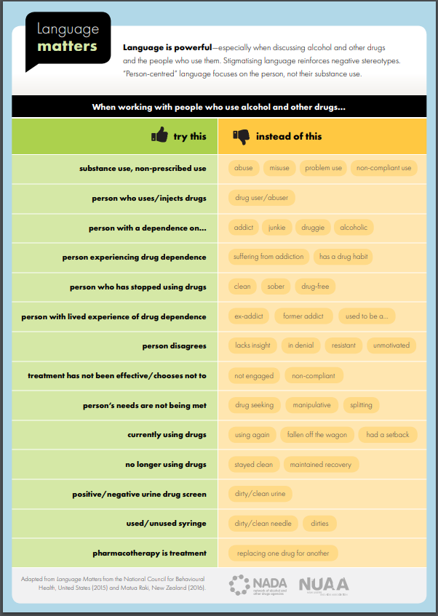
Language Matters
Notes:
Language is so important – you have a handout which provides you with a poster on helpful and unhelpful language.
Suzie to discuss this project and how it relates to working with families and their significant others.

Slide 16
Brainstorm with a partner….
What does Family Inclusive Practice mean to you?
Notes:
Brainstorming Activity: breaking into small groups/tables/pairs. Brainstorm and scribe What Family Inclusive Practice means to you, the organisation you work for, you have seen in other organisations……..
Set aside and we will return to your discussions…

Slide 17
Opportunities for support
Notes:
The experience of families and significant others – opportunities for support (FDS)
An FDS representative to explore the needs of families and significant others – present the cycle of change for families and what it might mean for AOD workers. Present some specific examples that illustrate these stages and the most useful response.

Slide 18
FAMILY DRUG SUPPORT CORE PRINCIPLES
Harm minimisation / reduction – keep people safe & alive
Family focused – acknowledge, validate, support
No advice giving – we don’t tell people what to do
Empowering families - Harnessing collective wisdom and experience
Non-judgmental - no right or wrong
Reality based - Being real and congruent, reality vs fantasy
Recognizing differences – stages and substances. Meeting people where they are
The past – acknowledging strengths and move focus
Creating safety – Express emotion and try new approaches
Self care – nourishing self physically, emotionally and spiritually
Notes:
FDS

Slide 19
HOW FAMILIES ACCESS SUPPORT -3 TYPES
Engaged
- active
- motivated
- educated
Engaged but disadvantaged
- active and motivated but don’t know how to
- cultural, language, literacy barriers
Disengaged
- uninvolved - burnt out - fearful of services
- generational drug and alcohol use (in some cases)
“Some do, some want to, some don’t…”
Notes:
FDS

Slide 20
IS IT MY FAULT???
I DON’T UNDERSTAND IT!!!
I
F
E
E
L
S
C
A
R
E
D
WHAT DO I DO????
Nothing makes sense anymore
WILL THEY DIE??
I am afraid…
Can I make them stop?
SHOULD I SAY ANYTHING?
WILL I SURVIVE??
What if I make it worse
Notes:
FDS

Slide 21
STAGES OF CHANGE – FAMILY MEMBERS - by Family Drug Support (2001)
Stage 1 – Denial
Stage 2 – Emotions (lots of it!!)
Stage 3 – Control
Stage 4 – Chaos
Stage 5 - Coping
Notes:
FDS

Slide 22
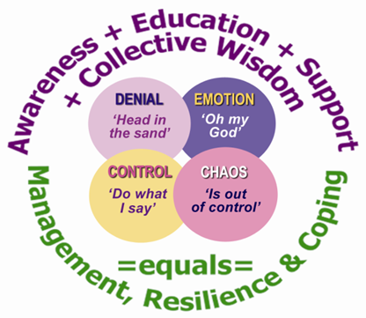
Stages if change family
Education
Support
Valuing self – self care
Notes:
FDS

Slide 23
CHANGING LANGUAGE & ATTITUDES
It is important that as workers we;
Drop labels
Refrain from unhelpful words and concepts
Remove blaming and shaming
Remember at all times;
Whoever the person is, they are someone’s son, daughter, partner, etc. A person who someone cares about and loves
Notes:
FDS

Slide 24
Why be inclusive of families?
Can assist in a client entering, or staying, in treatment
Can improve outcomes and family functioning for the client
Family members can show symptoms of stress that warrant help in their own right
Support can lead to a reduction in harm and distress experienced by significant others, including children.
Notes:
Suzie

Slide 25
Confidentiality and Privacy
NSW Health Privacy Principles
What concerns you in relation to Confidentiality and Privacy?
Finding the balance
Notes:
Suzie to facilitate a case study reflection exercise that unearths concerns around privacy and confidentiality – involving Steve Childs and other LHD reps if useful around how our policies guide us and how we can balance both confidentiality and privacy whilst engaging with families and sig. others.

Slide 26
Lunch

Slide 27
Activity: Family Inclusive Practice
What did you come up with?
What might
You add?
What might it mean for your practice?
Notes:
Revisit the groups brainstorming on what family inclusive practice means and what we might add

Slide 28
Principles of Family Inclusive Practice
All types of families have needs and rights that should be respected
Family members can be an important resource
The connection extends beyond treatment
Families can change and often want to learn how
Involving families in treatment services can lead to better outcomes for individual clients and their families.
Notes:
Staff are encouraged and supported to engage and involve families in the service.
Systems are in place (i.e. through assessment and other stages of treatment) to identify key family member/s that can support the client during treatment and after the client leaves the service.
Staff have the appropriate skills and knowledge to refer families to appropriate providers, if the service is unable to assist.
Staff have an obligation for the safety of clients and their families. The service has systems in place (i.e. though assessment) to ensure staff can identify when it is not appropriate to have family members involved in the treatment process and refer them to an appropriate provider. An example safety concern could be the existence of physical abuse.
Clients and families are aware of the services obligations in regards to confidentiality and consent. However, staff are encouraged to discuss with clients the benefits of having family actively involved in their treatment.
Staff are aware of and responsible for the provision of collaborative care, and work collectively with other health professionals involved in the continuum of care for the client and their family.
The service actively encourages staff, clients and families to be involved in service planning.

Slide 29
Family and Domestic Violence
Ask the question – open the door
Remember that domestic and family violence is not just physical — it can also be emotional, financial, spiritual, social, legal, reproductive, and can include stalking and neglect
1800RESPECT

Slide 30
Tips for families self care…
Talk about it - you are not alone
Get support
You can’t ‘fix’ your loved one
Set boundaries
Keep communicating
There are no short cuts, but even little steps your loved one takes are positive
Be realistic about treatment
There is hope
Notes:
• talk about it: Many families are affected by drug problems. You are not alone
• get expert help: There are lots of services to support people in your situation. Getting professional advice can help
you cope and can also benefit the person affected
• don’t think you can ‘fix’ your loved one: Only the person using substances can decide to give up or cut back on their drug use
• set boundaries: It’s important that the your love one understands your limitations. Keep communicating, and if you need help
with these skills, you may be able to join a support group if there is one in your area
• accept that change might take a long time: There are no short cuts, but even little steps your loved
one takes are positive
• be realistic about treatment: If your loved one lapses they won’t be the first. It often takes several rounds

Slide 31
Resilience
The ability to thrive in situations of high demand and ongoing pressure.
Involves being able to cope with and adapt to significant challenges, difficulties and setbacks,
And then use these experiences for learning and growth
How might you support this process?
Notes:
Draw out and emphasise what resilience is and is NOT
Resilience, like anything else, is not endless. Like a rubber band, if it is stretched to its limit too many times it will eventually break (https://managersandleaders.com.au/why-resilience-is-not-just-a-business-buzzword/)
Resilience is not about ‘pushing through’ - let’s not confuse survival with resilience (http://westkelownacounselling.com/resilience-not-coping-skills-gone-bad/)

Slide 32
Organisational Change

Slide 33
Specific Interventions
Ask about families and support networks at intake and assessment
Revisit and review support networks
Establishing Family support groups
Notes:
What can we do to enhance our services for families

Slide 34
Specific Interventions
Single-session therapy
- enlists the support of “family” while attending to their needs
- finds common ground
Open Dialogue
- support networks as partners
in the treatment process
Notes:
What can we do to enhance our services for families

Slide 35
Specific Interventions
Family/significant other sessions
Referral to specialist services
Resources and information
Telephone support
Notes:
What can we do to enhance our services for families

Slide 36
Considerations for children of our clients
Asking the
question
Children as a catalyst for change
Working with FaCS
Notes:
Explore considerations for young people and children of people who use substances.
Working with FaCS

Slide 37
Activity: Organisation Audit
what is happening currently in your organisation in relation to Family Inclusive Practice?
Identify organisational service delivery and skill changes necessary for achieving Family Inclusive Practice.
Develop practice standards and strategies for Family Inclusive Practice.

Slide 38
Afternoon Tea

Slide 39
Supports for families and significant others in your community

Slide 40
Local Services
Notes:
Facilitate a panel of local services who provide support to families and loved ones – brief presentations on what they provide and how to access their services

Slide 41
What’s missing in your region?
What are the service gaps for the families and significant others in your region?
What would assist our clients and their families?
Notes:
Facilitate some feedback and discussion around what the gaps in service delivery might be in relation to working with families?

Slide 42
Summary and Reflection

Slide 43
Reflection
What did you learn?
What do you want to know more about?
What actions will you take?
Notes:
What is your action plan? Not just for your organisation – what is YOUR action plan? What did you take away from today in terms of how you will enhance family inclusive practice?

Slide 44
Questions and Contacts

